Slide 1
Dynamic Programming III

Slide 2
Dynamic Programming
Technique for solving problems with overlapping subproblems.
Store subproblem solutions, save recomputing.
Create table of subproblem solutions.
“Programming” doesn’t refer to coding
Technique came from mathematics
Problems involving multi-stage planning
“Programming” meant “planning”

Slide 3
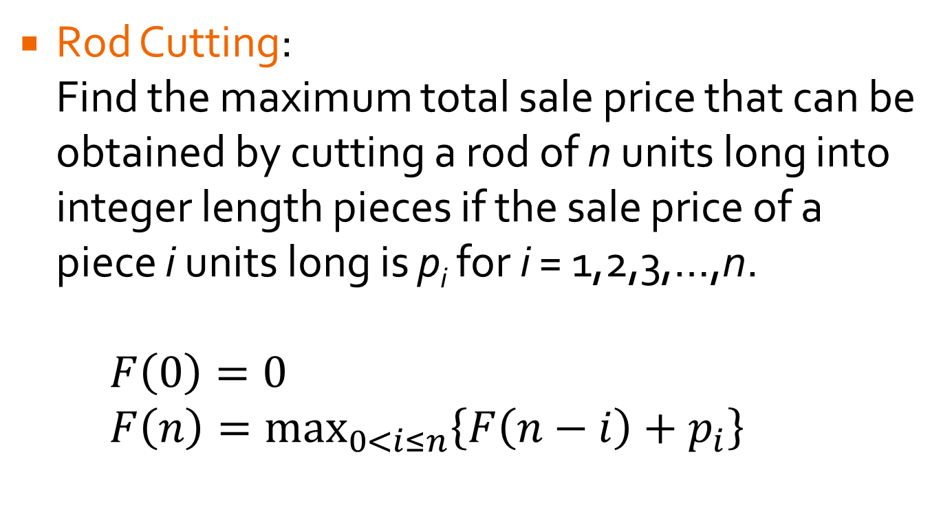
Last Time Lab
Rod Cutting: Find the maximum total sale price that can be obtained by cutting a rod of n units long into integer length pieces if the sale price of a piece i units long is p_{i} for i = 1,2,3,…,n.
$F\left(0\right)=0$
$F\left(n\right)=\max_{0<i≤n}\left\{F\left(n−i\right)+p_{i}\right\}$

Slide 4
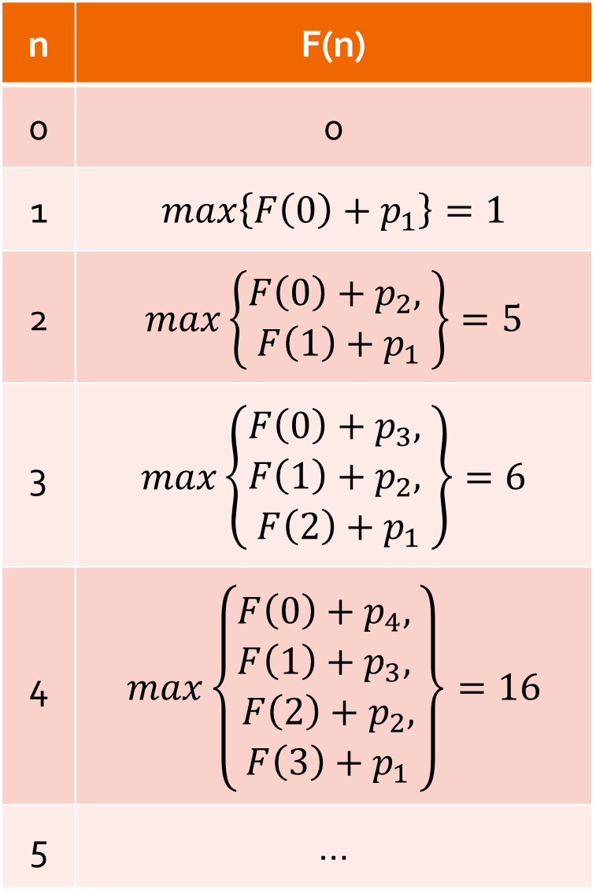
Last Time Lab
n | F(n)
0 | 0
1 | $$max\left\{F\left(0\right)+p_{1}\right\}=1$$
2 | $$max\left\{\begin{aligned}F\left(0\right)+p_{2}, \\ F\left(1\right)+p_{1}\end{aligned}\right\}=5$$
3 | $$max\left\{\begin{aligned}F\left(0\right)+p_{3}, \\ F\left(1\right)+p_{2}, \\ F\left(2\right)+p_{1}\end{aligned}\right\}=6$$
4 | $$max\left\{\begin{aligned}F\left(0\right)+p_{4}, \\ F\left(1\right)+p_{3}, \\ F\left(2\right)+p_{2}, \\ F\left(3\right)+p_{1}\end{aligned}\right\}=16$$
5 | …
Rod Cutting: Example You have a rod 6 units long and can sell: 1 unit for $1, 2 units for $5, 3 units for $5, 4 units for $16, 5 units for $3 and 6 units for $12.
Time and Space efficiency?

Slide 5
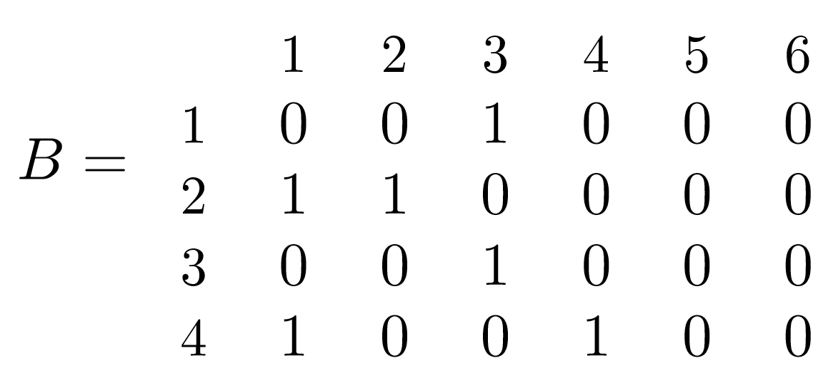
Last Time Lab
Maximum Square Submatrix: Given an mxn Boolean matrix B, find its largest square submatrix whose elements are all zeros (imagine finding largest empty space in a plan).
F(i,j) = biggest empty square (i,j) is bottom right corner of.

Slide 6

Last Time Lab
F(i,j) = biggest empty square (i,j) is bottom right corner of.
$$F\left(i,j\right)=\left\{\begin{aligned}0 if \left(i,j\right) is 1 \\ min\left\{F\left(i−1,j\right), F\left(i,j−1\right), F(i−1,j−1)\right\}+1 if \left(i,j\right)is 0\end{aligned}\right.$$
$$F\left(0,j\right)=F\left(i,0\right)=0$$
 | 0 | 1 | 2 | 3 | 4 | 5 | 6
0 | 0 | 0 | 0 | 0 | 0 | 0 | 0
1 | 0 | 1 | 1 | 0 | 1 | 1 | 1
2 | 0 | 0 | 0 | 1 | 1 | 2 | 2
3 | 0 | 1 | 1 | 0 | 1 | 2 | 3
4 | 0 | 0 | 1 | 1 | 0 | 1 | 2

Slide 7
Knapsack Problem
You have a set of n items with weights w₁, w₂, …, w_{n} and values v₁, v₂, …, v_{n}. You have a knapsack that can hold a total weight of W. What’s the most valuable subset of items you can fit in the knapsack?
Assume weights are integers (values needn’t be)
W = 10
w₁ = 7
v₁ = $42
w₁ = 5
v₁ = $25
w₃ = 4
v₃ = $40
w₂ = 3
v₂ = $12

Slide 8
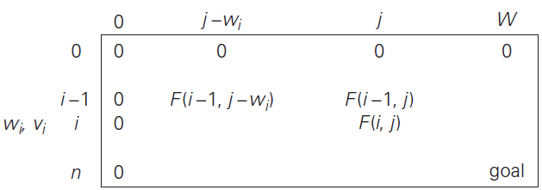

Knapsack Problem
Let F(i,j) be optimal solution to problem with first i items and capacity j.
Some solutions don’t include item i: F(i-1, j)
Others include i: v_{i} + F(i-1, j-w_{i})
Notes:
If item i is larger than capacity j, then F(i,j) = F(i-1,j)

Slide 9
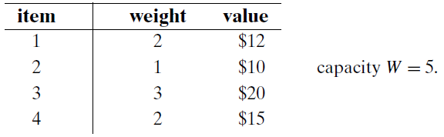
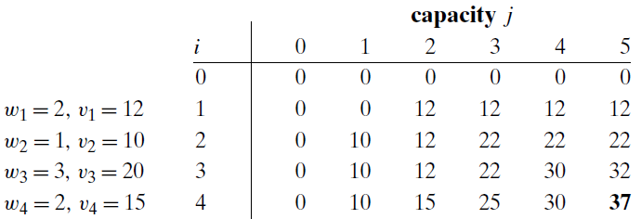
Knapsack Problem: Θ(nW)
Problem:
Solution: What does the table look like?

Slide 10
Knapsack Problem: Θ(nW)
Problem:
Solution:
Notes:
Time and Space efficiency theta(nW)

Slide 11
Approaching Problems
Direct Top-Down Approach:
Resolve overlapping subproblems
Very inefficient – typically exponential
Classic Dynamic Programming:
Bottom-Up
Fills Table with Solutions to all smaller subproblems
Each subproblem solved only once
Not all subproblems are needed
Can we get the best of both?

Slide 12
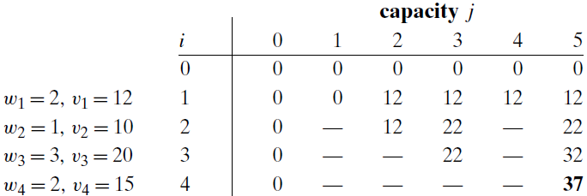
Memory
Memory Function approach:
Initialize table to “uncomputed” value
Fill in values as needed.
After first time, can simply look up value

